Slide 1
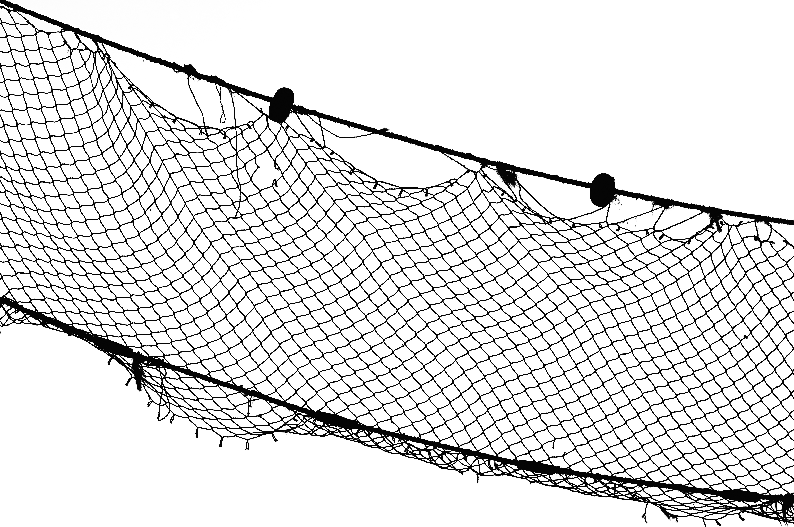


Behavior and Social Structure
Taylor Bogiel
The central research question my project will address: How does dolphin relatedness and foraging behavioral traits establish social structure?

Slide 2
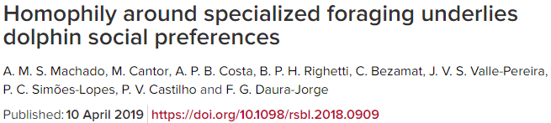
Motivation and Background
Animal behavior is an under represented field of science that still has a lot to discover.
I found this really neat article.

Slide 3
Approach
I will answer this question by using the following data sets from Dryad:
They had to create a photo-identification chart to identify different dolphins
Behavioral contexts consit of: cooperative foraging, non-cooperative foraging, and non-foraging

Slide 4
About the Data
The data within the 4 files includes matrices with photo-identification protocols, home range overlap values, co variables of 52 photo-identified individuals, and pair wise genetic relatedness.

Slide 5
Anticipated Details
The analysis will involve testing for social preferences between dyads, population-level social division, and the network assortativity.
The specialized foraging tactic will be coupled to social preferences and social division by testing the network assortativity.

Slide 6
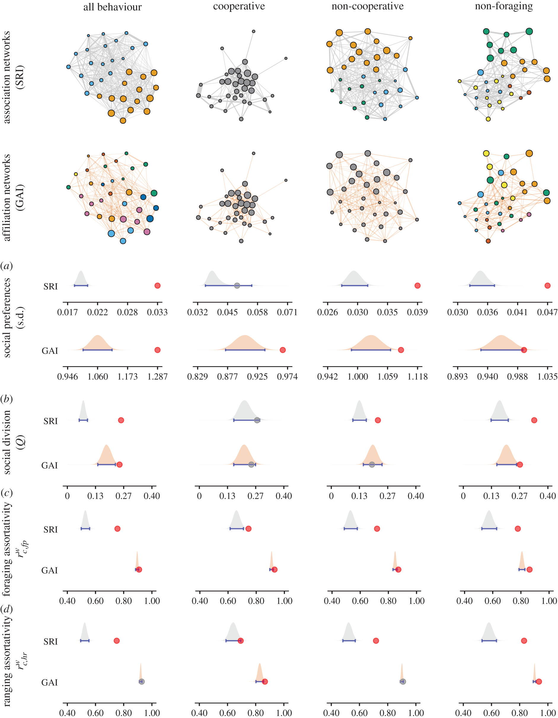
Anticipated Results
Behavioral specializations can define social affiliations and shape animal social structure.

